Slide 1
Business Data Communications
Fourteenth Edition
Jerry FitzGerald, Alan Dennis, and Alexandra Durcikova
Chapter 1
Introduction to Data Communications

Slide 2
Learning Objectives
Discuss the applications of data communications networks.
Explain how data communications fit within the discipline of Computer Science (CS) and Info Science (IS).
Discuss the major components of and types of networks.
Discuss the role of network layers.
Discuss the role of network standards.
Discuss cyber security issues.
Discuss three key trends in communications and network.

Slide 3
Industrial Revolutions
The first revolutionized the way people worked at the end of the 18th century by introducing machines, steam and waterpower.
The second in the late 19th century is known for starting mass production, electricity, and the telephone.
The third, in the second half of the 20th century, is revolutionizing the way people work through electronics and information technology (IT) to automate production.
The fourth is currently underway
It merges the physical, digital, and biological worlds
It is deeply rooted in the Internet and digitization.

Slide 4
1.1 Introduction
A high-speed data communications network brings people together in a way never before possible.
Collapsing the information lag to Internet speeds means that people can communicate and access information anywhere in the world regardless of their physical location.
Data communications and networking is a truly global area of study
Different political and regulatory issues that have evolved and currently exist in different parts of the world.

Slide 5
Three Fundamental Questions
How does the Internet work?
Chapters 1-5
How do I design a network?
Chapters 6-10
How do I manage my network to make sure it is secure, provides good performance, and doesn’t cost too much?
Chapters 11-12

Slide 6
Core IT Capabilities within Organizational Settings
Storing and retrieving data
Analyzing and visualizing data
Automating data operations
Protecting data

Slide 7
What is MIS?

Slide 8
1.2 Data Communications Networks
Data communications is the movement of computer information from one point to another by means of electrical or optical transmission systems
Such systems are often called data communications networks
There are three basic hardware components for a data communications network:
The server stores data or software that can be accessed by the clients
The client is the input–output hardware device at the user’s end of a communication circuit
The circuit is the pathway through which the messages travel
A network without a server is called a peer-to-peer network.

Slide 9
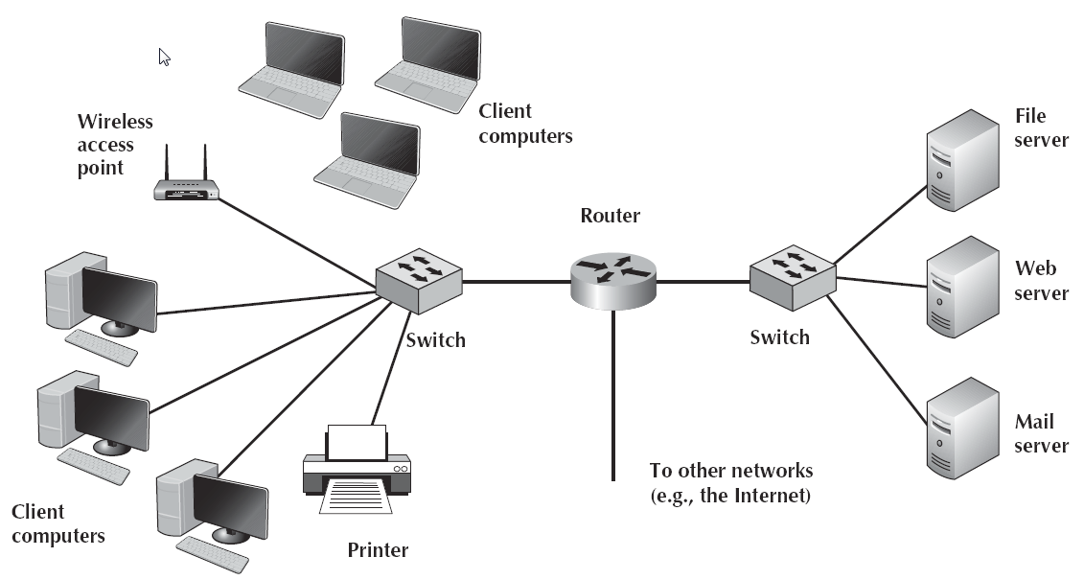
Example of a Local Area Network (LAN)

Slide 10
LAN Terms
This network that has several personal computers (clients) connected through a switch and cables (circuit).
Computers also connect wirelessly through a wireless access point (AP)
The router is a special device that connects two or more networks
Enables computers on this network to communicate with computers on the same network or on the Internet.

Slide 11
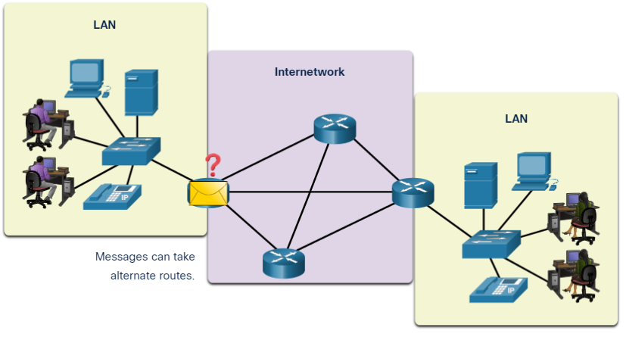
Network Components - End Devices
An end device is where a message originates from or where it is received. Data originates with an end device, flows through the network, and arrives at an end device.

Slide 12
Network Components - Intermediary Network Devices
An intermediary device interconnects end devices. Examples include switches, wireless access points, and routers.
Management of data as it flows through a network is also the role of an intermediary device, including:
Regenerate and retransmit data signals.
Maintain information about what pathways exist in the network.
Notify other devices of errors and communication failures.

Slide 13
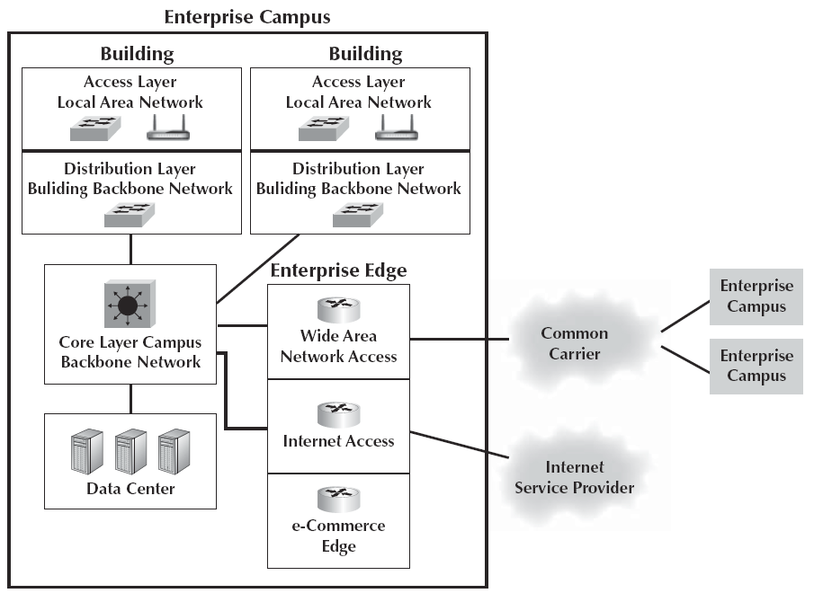
Server Types
The file server stores data and software that can be used by computers on the network.
The Web server stores documents and graphics that can be accessed from any Web browser.
The mail server handles and delivers email over the network.

Slide 14
Types of Networks
A local area network (LAN) is a group of computers located in the same general area
A LAN covers a clearly defined small area
Commonly operating at 100 million bits per second (100 Mbps).
Most LANs are connected to a backbone network (BN), a larger, central network connecting several LANs, other BNs, MANs, and WANs.
Typically, hundreds of feet to several miles
Typically, 100-1,000 Mbps
Wide area networks (WANs) connect BNs and MANs.
Most organizations do not build their own WANs.

Slide 15
Intranets and Extranets
An intranet is a LAN that uses the same technologies as the Internet but is open to only those inside the organization.
Sometimes, an intranet is provided by a completely separate Web server hidden from the Internet.
An extranet is a LAN that uses the same technologies as the Internet but is provided to invited users outside the organization who access it over the Internet
It can provide access to information services, inventories, and other internal organizational databases that are provided only to customers, suppliers, or those who have paid for access.

Slide 16
1.3 Network Models
All networks provide the same basic functions to transfer a message from sender to receiver.
Each network can use different network hardware and software to provide these functions.
One way is to break the entire set of communications functions into a series of layers.
There are many different ways in which the network layers can be designed
The two most important network models are the Open Systems Interconnection Reference (OSI) model and the Internet model (TCP/IP).

Slide 17
Open Systems Interconnection (OSI) Reference Model
Before the OSI model, most commercial networks used by businesses were built using non-standardized technologies developed by one vendor
OSI model produced in 1984 by the Open System Interconnection Subcommittee of the International Organization for Standardization (ISO)
The OSI model is the most referred to network model.
However, you will probably never use a network based on the OSI model
The OSI model never caught on commercially in North America; although, some European networks use it.

Slide 18
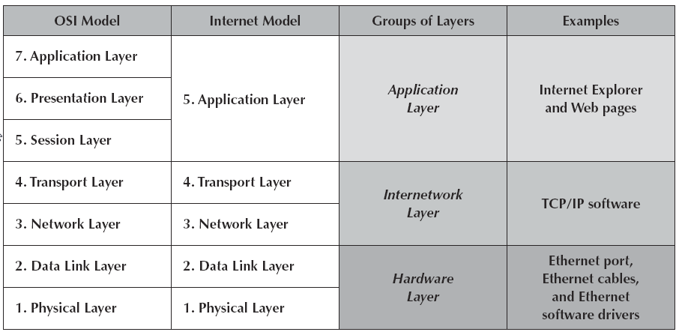
Network Models

Slide 19
Seven Layers of the OSI Model
Layer 1: Physical Layer
The physical layer is concerned primarily with transmitting data bits (zeros or ones) over a communication circuit.
Layer 2: Data Link Layer
The data link layer manages the physical transmission circuit in layer 1
Transforms it into a circuit that is free of transmission errors as far as layers above are concerned.
Solve the problems caused by damaged, lost, or duplicate messages so the succeeding layers are shielded from transmission errors.
Layer 3: Network Layer
The network layer performs routing

Slide 20
Seven Layers of the OSI Model - Continued
Layer 4: Transport Layer
The transport layer deals with end-to-end issues, such as procedures for entering and departing from the network
Maintains logical connections
Makes sure that packets are received
Layer 5: Session Layer
The session layer is responsible for managing and structuring all sessions
Handles session accounting so the correct party receives the bill.

Slide 21
Seven Layers of the OSI Model Continued
Layer 6: Presentation Layer
The presentation layer formats the data for presentation to the user
Its job is to accommodate different interfaces on different computers, so the application program need not worry about them.
Layer 7: Application Layer
The application layer is the end user’s access to the network
The primary purpose is to provide a set of utilities for application programs.

Slide 22
Internet Model (TCP/IP)
The network model that dominates current hardware and software is a simple five-layer Internet model.
Evolved from the work of thousands of people who developed pieces of the Internet.

Slide 23
Five Layers of the Internet Model (TCP/IP)
Layer 1: The Physical Layer
The physical layer in the Internet model is the physical connection between the sender and receiver.
The physical layer includes all the hardware devices and physical media
Layer 2: The Data Link Layer
The data link layer is responsible for moving a message from one computer to the next computer in the network path from the sender to the receiver.
Controls the physical layer by deciding when to transmit messages over the media
Formats the messages by indicating where they start and end
Detects and may correct any errors that have occurred during transmission

Slide 24
Five Layers of the Internet Model Continued
Layer 3: Network Layer
The network layer performs routing
it can find the address of that computer if it does not already know it
Layer 4:The Transport Layer
It is responsible for linking the application layer software to the network and establishing end-to-end connections.
It is responsible for breaking long messages into several smaller messages and then recombining the smaller messages back into the original larger message at the receiving end
Layer 5: Application Layer
The application layer is the application software used by the network user

Slide 25
Groups of Layers
The layers in the Internet are often so closely coupled that decisions in one layer impose certain requirements on other layers.
The data link layer and the physical layer are closely tied
Because of this, decisions about the data link layer often drive the decisions about the physical layer.
Some people group them together and call them the hardware layer
The transport and network layers are so closely coupled that sometimes these layers are called the internetwork layers.

Slide 26
Message Transmission Using Layers
Each computer in the network has software that operates at each of the layers and performs the functions required by those layers
Each layer in the network uses a formal language, or protocol, that is simply a set of rules that define what the layer will do
In general, all messages sent in a network pass through all layers
All layers except the physical layer create a new Protocol Data Unit (PDU) as the message passes through them.
Contains information that is needed to transmit the message through the network
Some experts use the word packet to mean a PDU.

Slide 27
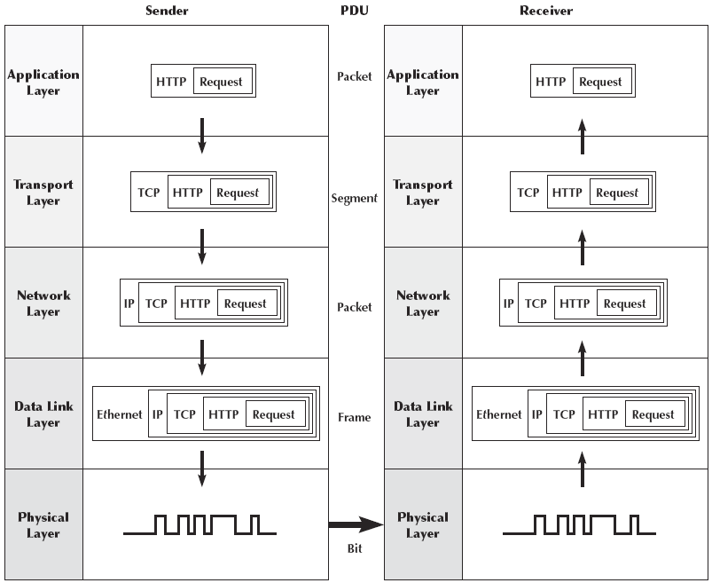
Message Transmission using Layers Visually

Slide 28
Application Layer
The user creates a message at the application layer using a Web browser by clicking on a link.
The browser translates the user’s message into HTTP.
The Web browser fills in the necessary information in the HTTP packet, drops the user’s request inside the packet, then passes the HTTP packet to the transport layer.

Slide 29
Transport Layer
The transport layer on the Internet uses a protocol called TCP (transmission control protocol).
TCP is responsible for breaking large files into smaller packets and for opening a connection to the server for the transfer of a large set of packets.
The transport layer places the HTTP packet inside a TCP PDU fills in the information needed by the TCP segment and passes the TCP segment to the network layer.

Slide 30
Network Layer
The network layer on the Internet uses a protocol called IP (Internet Protocol)
IP selects the next stop on the message’s route through the network.
It places the TCP segment inside an IP PDU and passes the IP packet to the data link layer.

Slide 31

Data Link Layer
The data link layer uses a protocol called Ethernet to connect to the Internet.
The data link layer formats the message with start and stop markers, adds error checks information.
It instructs the physical hardware to transmit the Ethernet frame.
Structure of a Frame

Slide 32
Physical Layer
The physical layer in this case is network cable connecting your computer to the rest of the network.
The computer will take the Ethernet frame and send it as a series of electrical pulses through your cable to the server.

Slide 33
The Pros and Cons of using Layers
There are many different software packages and many different PDUs that operate at different layers to successfully transfer a message
Networking is in some ways similar to the Russian nested dolls
This is called encapsulation, because the PDU at a higher level is placed inside the PDU at a lower level.
For communication to be successful, each layer in one computer must be able to communicate with its matching layer in the other computer
Ensuring that the software used at the different layers is the same as accomplished by using standards
A standard defines a set of rules, called protocols
The major disadvantage of using a layered network model is that it is somewhat inefficient
Because there are several layers, a message involves many software programs and PDUs

Slide 34
1.4 Network Standards
Standards are necessary in almost every business and public service entity
The primary reason for standards is to ensure that hardware and software produced by different vendors can work together
Standards also mean that customers are not locked into one vendor
The use of standards makes it much easier to develop software and hardware that link different networks because software and hardware can be developed one layer at a time.

Slide 35
The Standards-Making Process
There are two types of standards:
De jure (official)
De facto (vendor supported but no official standing)
A de jure standard is developed by an official industry or a government body and is often called a formal standard
Typically take several to develop
Specifications
Identification of choices
Acceptance
De facto standards are those that emerge in the marketplace and are supported by several vendors but have no official standing.

Slide 36
Standard Making Organizations
International Organization for Standardization
The membership is composed of the national standards organizations of each ISO member country
International Telecommunications Union-Telecommunications Group (ITU‑T)
The technical standards-setting organization of the United Nations International Telecommunications Union
American National Standards Institute (ANSI)
The coordinating organization for the U.S. national system of standards for both technology and nontechnology.

Slide 37
Standard Making Organizations Continued
Institute of Electrical and Electronics Engineers (IEEE)
A professional society in the United States whose Standards Association (IEEE-SA) develops standards. E.g. IEEE 802.3 for Ethernet; 802.11 for wireless LAN
Internet Engineering Task Force (IETF)
Sets the standards that govern how much of the Internet will operate.

Slide 38
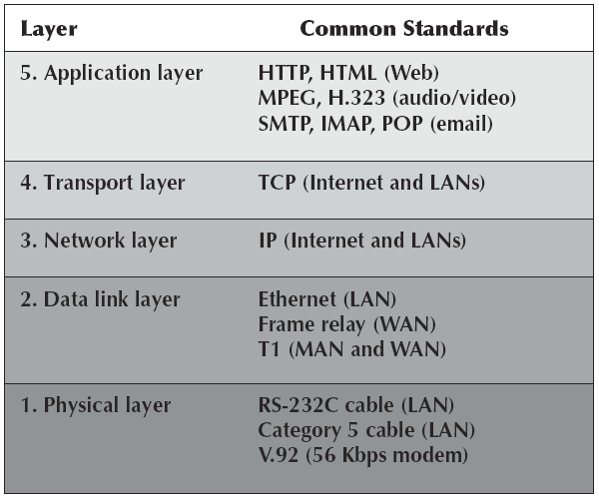
Some Common Data Communications Standards

Slide 39
1.5 Future Trends
Wireless LAN and BYOD
The rapid development of mobile devices has encouraged employers to allow their employees to bring these devices to work and use them to access data
Employers face myriad decisions about how to manage access to company applications for BYOD
The Internet of things
In the future, the Internet will move from being a Web of computers to also being an Internet of Things (IoT), as smart devices become common, that creates the Network of Things (NoT)
Massively online
Games are massively online
Education is massively online

Slide 40
1.6 Implications for Cyber Security
Networks and the Internet change almost everything
Today’s networking environment requires that a wide variety of devices could connect.
As the demand for network services and network capacity increases, so too will the need for secure storage and server space and secure transfer of data.

